Slide 1
Project 3
Integrate Grafana with Linux Server for high cpu utilization and create a graph in Grafana.
Presented by krati pandey

Slide 2
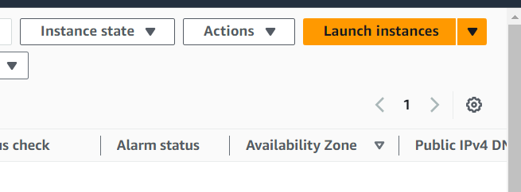
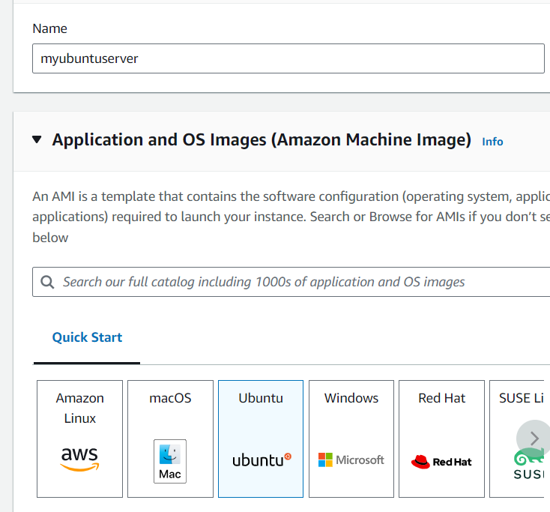
Step 1: Sign to the AWS console select region Asia Pacific(Mumbai) ap-south-1
Go to the EC2.
Step 2: Select instance & launch an instance.
Step 3:Enter your instance name & select ubuntu .

Slide 3
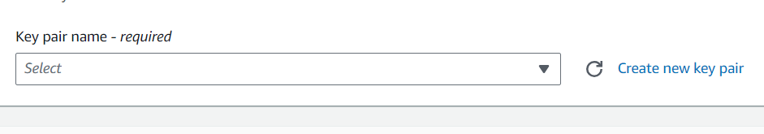
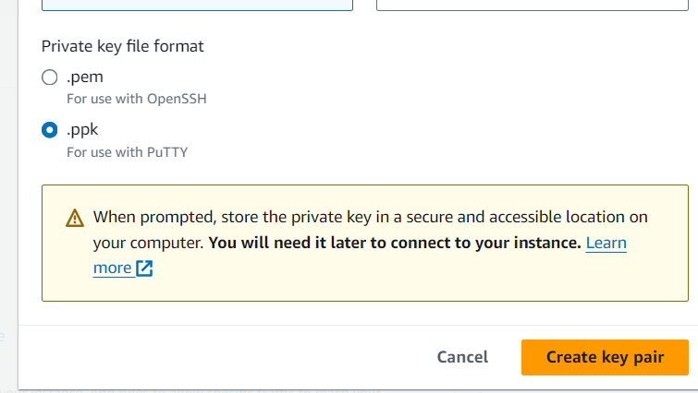
Step 4: Then select create a new keypair .
Step 5: Enter keypair name & select . ppk then click on create key pair.

Slide 4
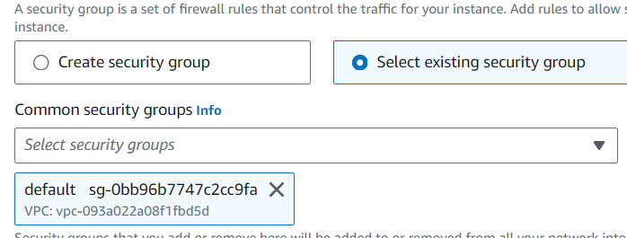
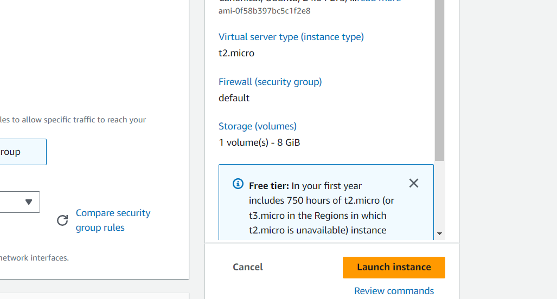
Step 6: Then select existing security group default .click on launch instance.

Slide 5
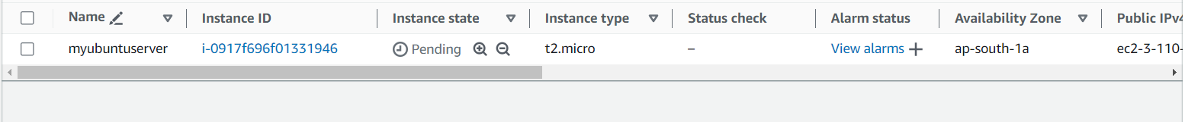
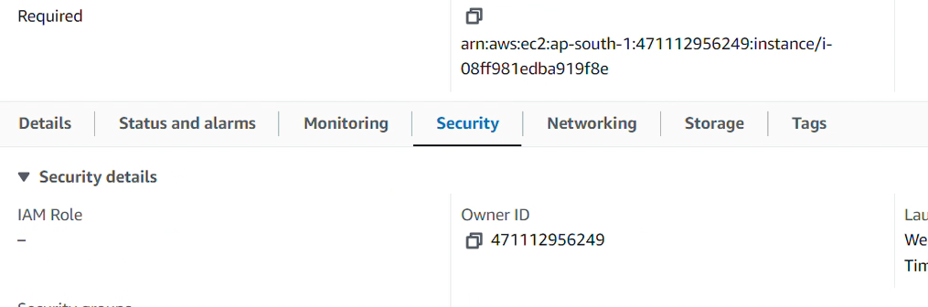
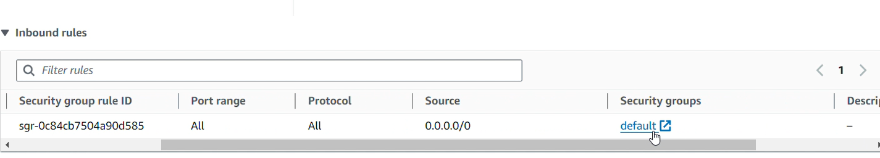
Now Your instance has been launched.
Step 7: Open the instance by clicking the instance id & go to security.
Under security go to the inbound rules & click on default.

Slide 6
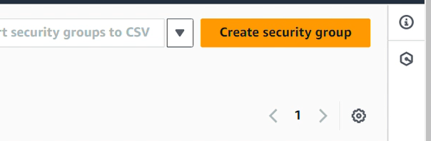
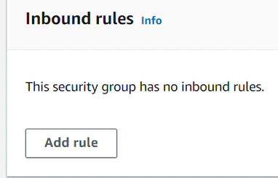
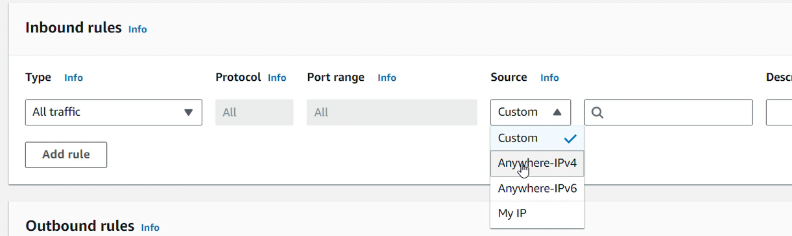
Then click on create security group & click add rule.
In type info select all traffic and in source info select anywhere-Ipv4 then click create security group.

Slide 7
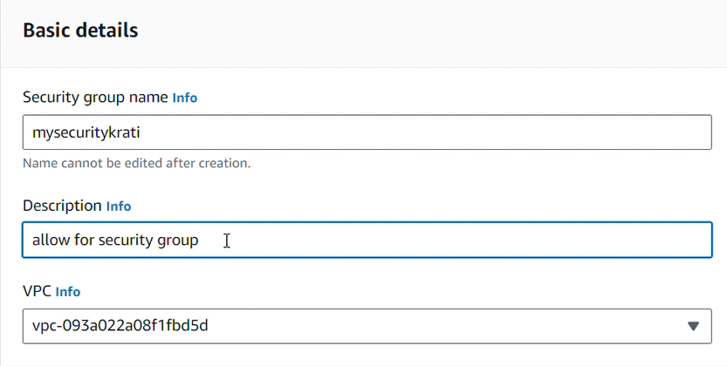
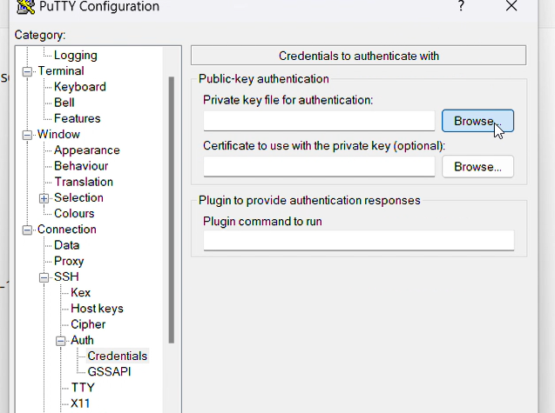
Enter your security group name & in description allow for security group. Click on create security group.
Step 8: Open putty enter your public Ip . Click browse.

Slide 8

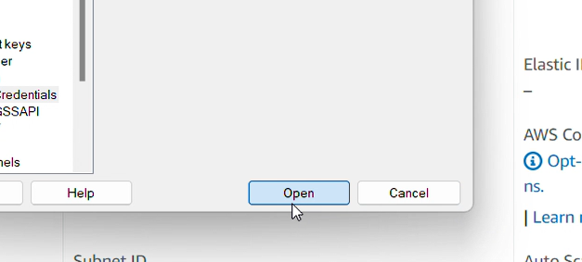

Select the key pair & open it.
Step 9: Login as ubuntu.
Enter these commands.

Slide 9








Slide 10
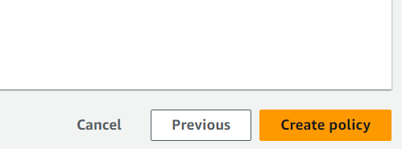
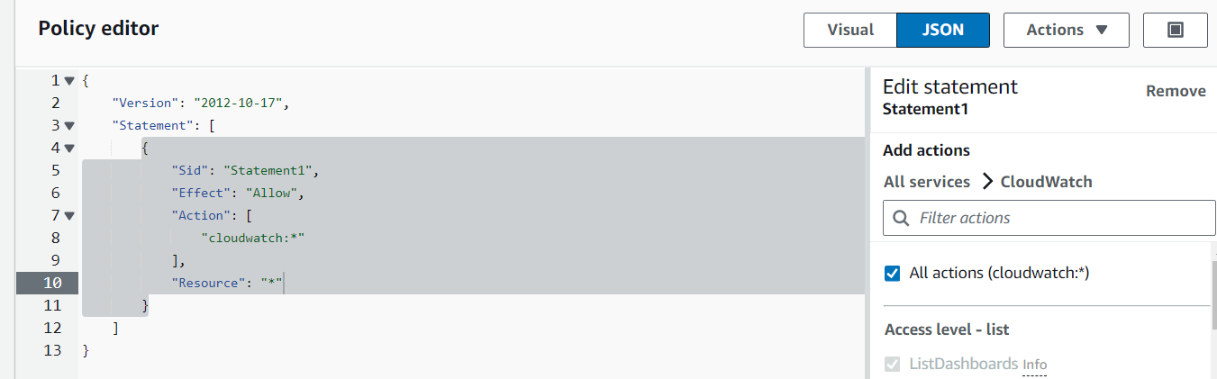
Step 10: Now go to the IAM select policies & click on create policy.
Click on JSON add action cloud watch & put resource Resource : “*” . Click on create policy.

Slide 11
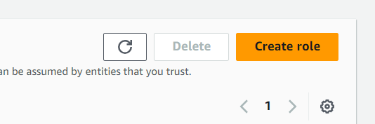
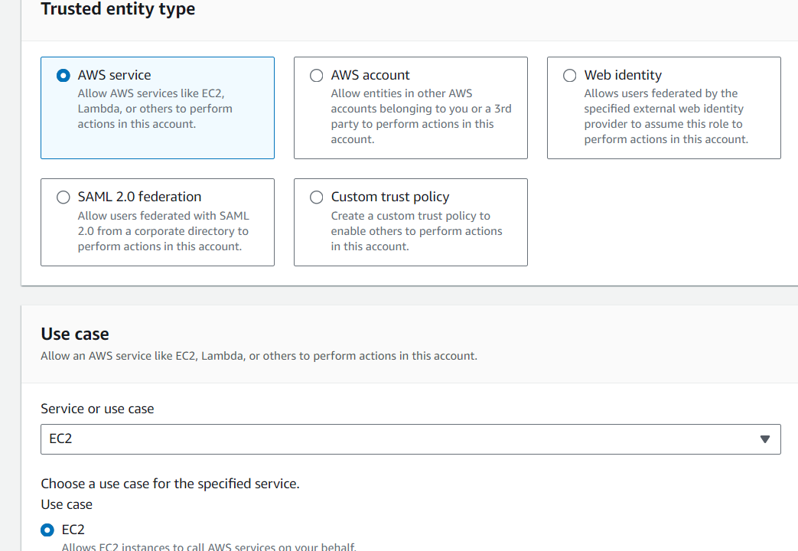
Step 11. Now go to the roles click on create role.
Select AWS service & use case EC2. Click on next.

Slide 12
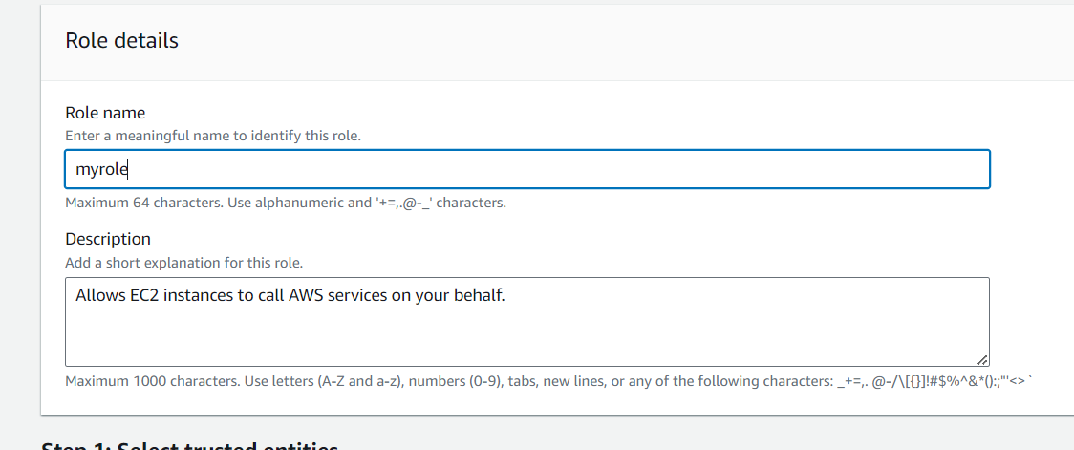
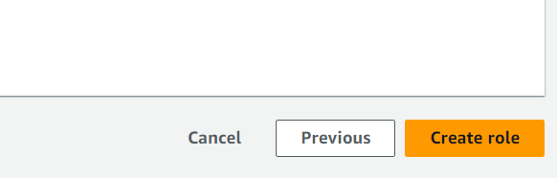
Now enter your role name & click on create role. Your role has been created.

Slide 13
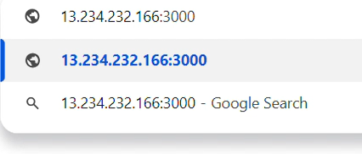
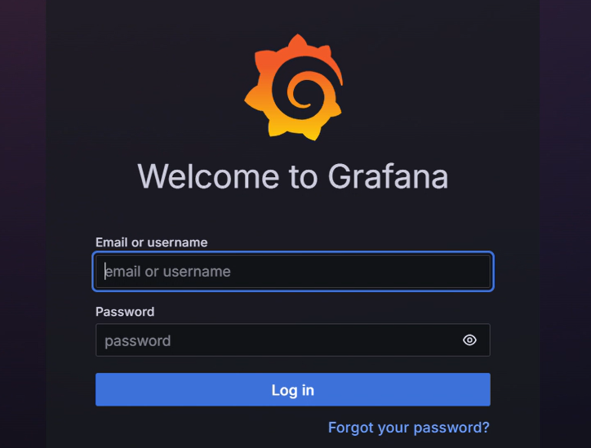
Step 12: To enter in Grafana enter your instance private ip:3000 and search it.
Enter username & password “admin”

Slide 14
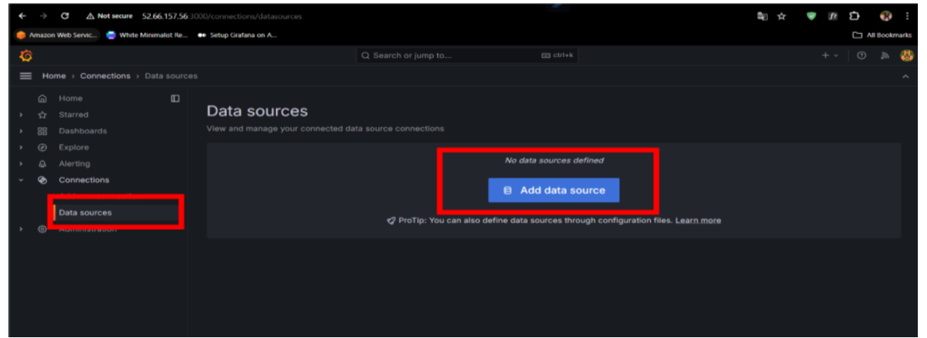
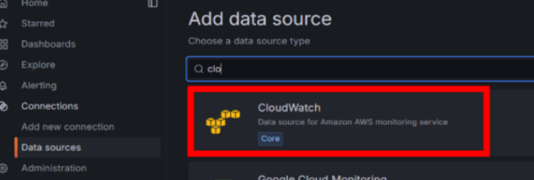
Then go to data resources & click add data resources.
Then search cloud watch.

Slide 15
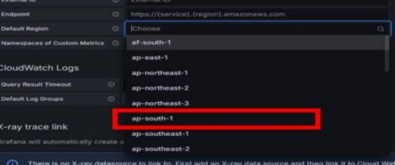
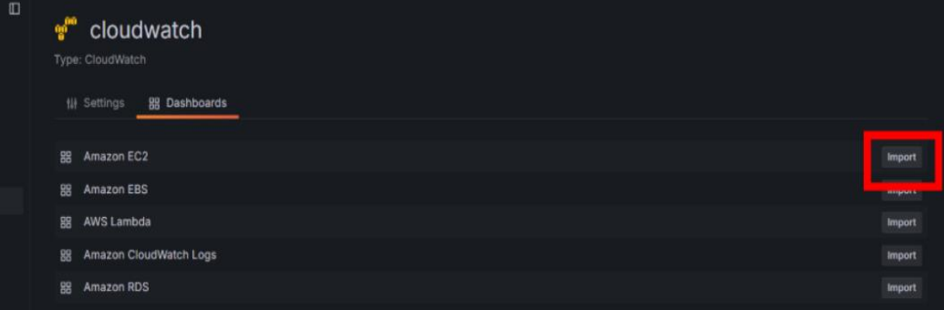
Choose region ap-south-1.
Then go to the dashboard & import amazon EC2.

Slide 16
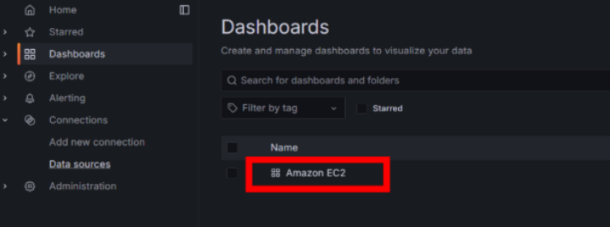
Go to the dashboard select your Amazon EC2.

Slide 17
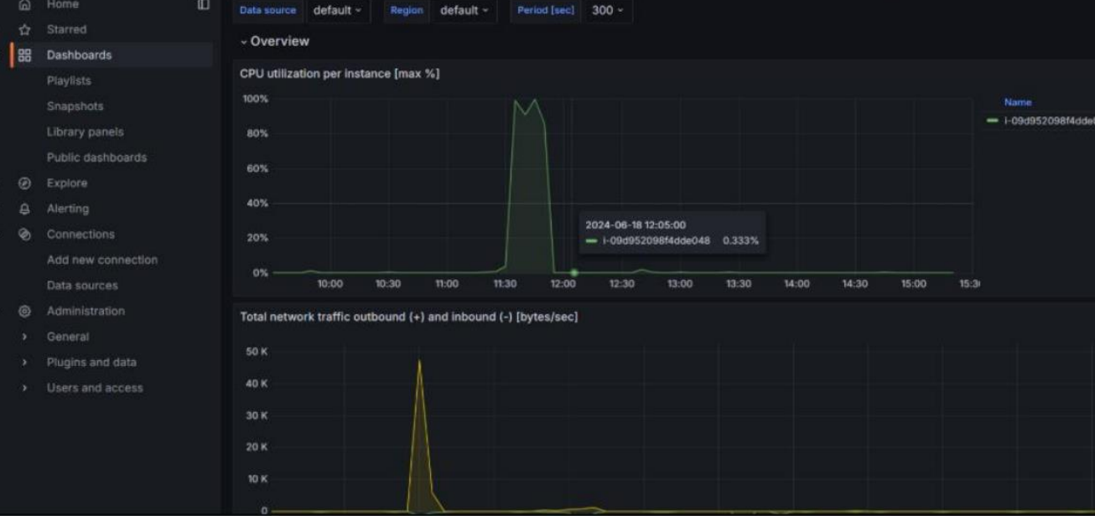

Slide 18
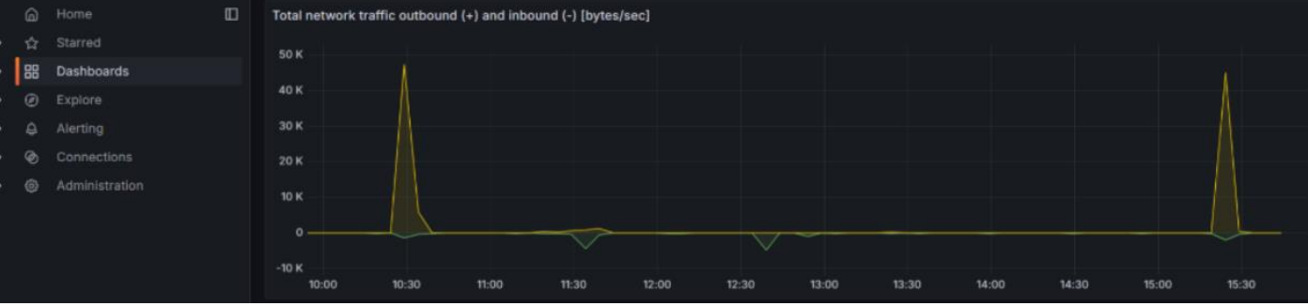
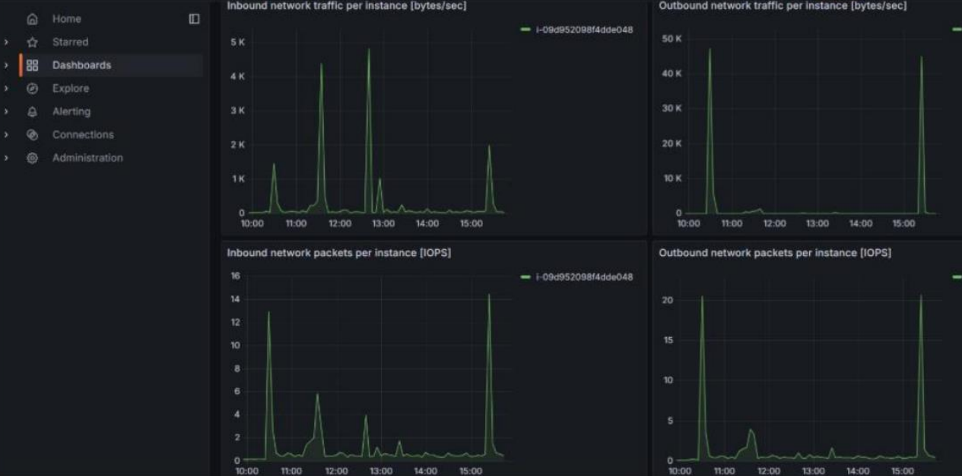

Slide 19
THANK YOU
SUBMITTED BY KRATI PANDEY

